Slide 1
Acute liver injury
Mohammad Almeqdadi, MD
GI Fellow

Slide 2
Case
History of presenting illness
The patient is a 50-year-old gentleman who presented to the hospital with six days of fatigue, malaise, multiple episodes of non-bloody nonbilious vomiting, abdominal distension and diffuse abdominal pain.
Three days prior to presentation, he was noted to be jaundiced, and was brought to the hospital by his family members.

Slide 3
Case
History of presenting illness
He had hyperlipidemia, and 7 months before admission he had taken an unknown cholesterol-lowering medication for a period of 2 months.
He currently takes no medications, herbal supplements, or Ayurvedic therapies.
What else do you want to ask?

Slide 4
Case
History of presenting illness
He had hyperlipidemia, and 7 months before admission he had taken an unknown cholesterol-lowering medication for a period of 2 months.
He currently takes no medications, herbal supplements, or Ayurvedic therapies.
He last drank alcohol 6 months before admission, but he previously drank in a binge pattern, consuming 8 to 10 alcoholic drinks at a time, several days per month.

Slide 5
Case
History of presenting illness
He had hyperlipidemia, and 7 months before admission he had taken an unknown cholesterol-lowering medication for a period of 2 months.
He currently takes no medications, herbal supplements, or Ayurvedic therapies.
He last drank alcohol 6 months before admission, but he previously drank in a binge pattern, consuming 8 to 10 alcoholic drinks at a time, several days per month.
He resided in a rural community in northern India, worked as a horticulturalist, and had cattle on his property.

Slide 6
Case
History of presenting illness
He had hyperlipidemia, and 7 months before admission he had taken an unknown cholesterol-lowering medication for a period of 2 months.
He currently takes no medications, herbal supplements, or Ayurvedic therapies.
He last drank alcohol 6 months before admission, but he previously drank in a binge pattern, consuming 8 to 10 alcoholic drinks at a time, several days per month.
He resided in a rural community in northern India, worked as a horticulturalist, and had cattle on his property.
His father had reportedly died of an unspecified form of liver disease in his sixth decade of life.

Slide 7
Case
Physical examination
T 36.9°C
BP 138/82
HR 90
RR 14, O2 94% on 4L NC
He was alert and oriented and had no dysarthria or asterixis. The skin was jaundiced, and the sclerae were icteric. The skin was without spider angiomas or palmar erythema.
The first and second heart sounds were normal and without murmurs, and the jugular venous pulsation was not distended.
Bowel sounds were present, and the abdomen was soft and mildly dis- tended, with minimally diffuse tenderness to palpation.
The liver edge was palpable and nontender, with no splenomegaly.
There was no edema in his arms or legs.
Rectal examination revealed brown stool that tested positive for fecal occult blood.

Slide 8
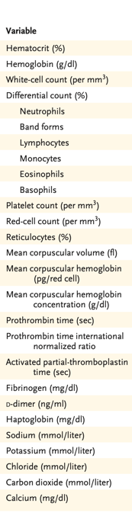
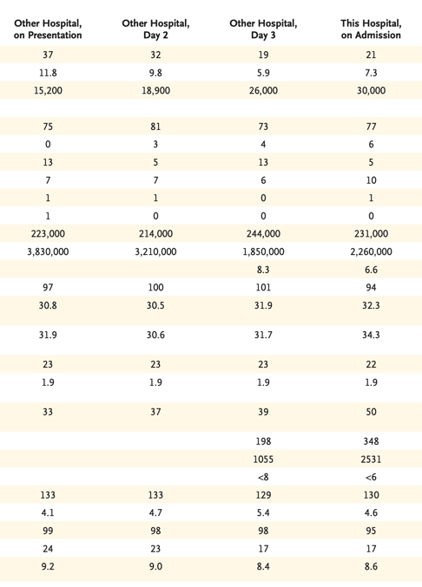


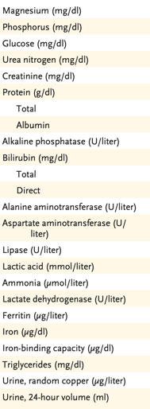
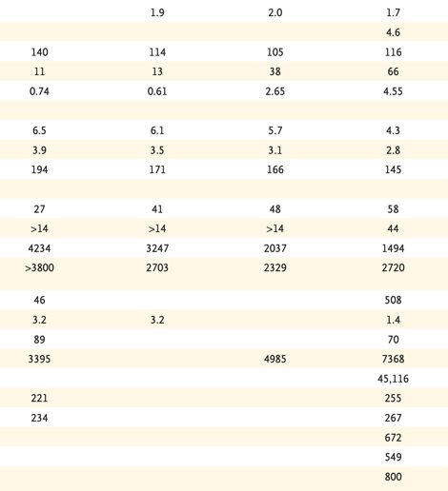

Slide 10
What are your differential diagnoses?

Slide 11
What are your differential diagnoses?
Acute liver injury secondary to
{insert all causes of hepatotoxicity here}

Slide 12
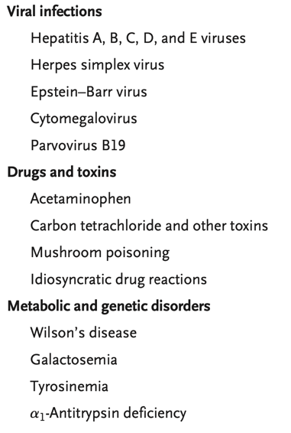
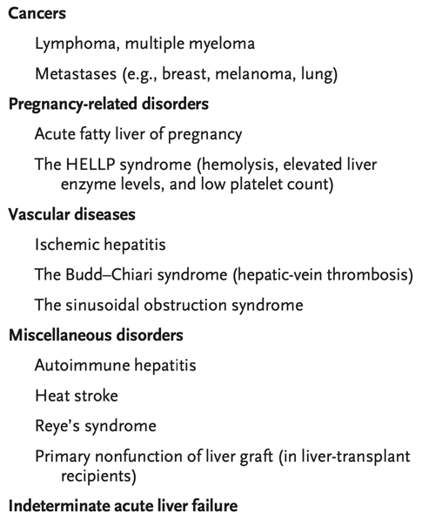
Differential Diagnoses

Slide 13
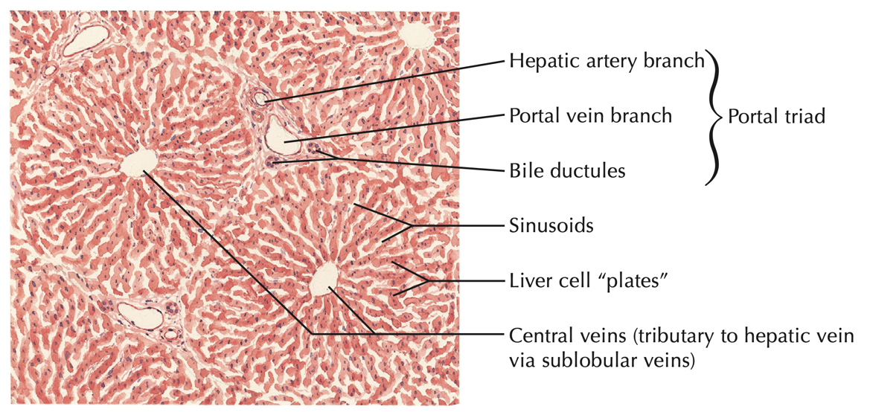
Normal Histology of the Liver

Slide 14
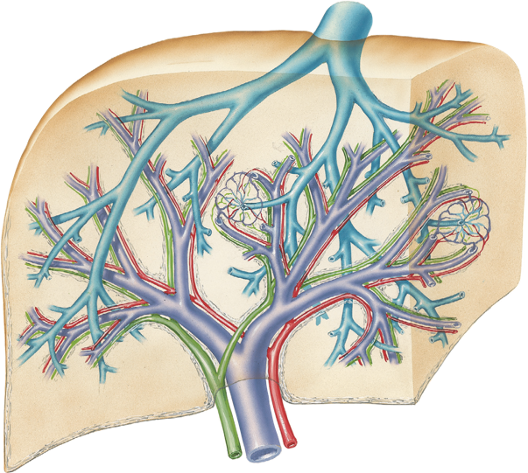
Drainage of the Liver

Slide 15
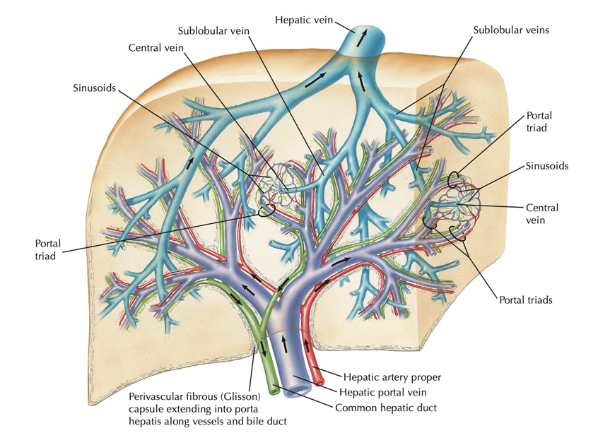

Drainage of the Liver

Slide 16
Transaminitis

Slide 17
Transaminitis
What does this mean?

Slide 18
Transaminitis
Inflammation of the transaminase

Slide 19
Transaminitis
Inflammation of the transaminase
Would you diagnose creatininitis or troponinitis?

Slide 20
“Liver Function Tests” vs.
Liver Function Tests

Slide 21
“Liver Function Tests” vs. Liver Function Tests
Liver enzymes or liver chemistries | Liver synthetic function tests
Tests that reflect the integrity of the hepatobiliary system. | Tests that reflect the physiologic synthetic function of the liver.
ALT, AST, GGT, T bili, 5’NT, etc.

Slide 22
“Liver Function Tests” vs. Liver Function Tests
Liver enzymes or liver chemistries | Liver synthetic function tests
Tests that reflect the integrity of the hepatobiliary system. | Tests that reflect the physiologic synthetic function of the liver.
ALT, AST, GGT, T bili, 5’NT, etc. | What are those?

Slide 23
“Liver Function Tests” vs. Liver Function Tests
Liver enzymes or liver chemistries | Liver synthetic function tests
Tests that reflect the integrity of the hepatobiliary system. | Tests that reflect the physiologic synthetic function of the liver.
ALT, AST, GGT, T bili, 5’NT, etc. | Albumin, prothrombin time

Slide 24
Metabolism of a hepatocyte

Slide 25
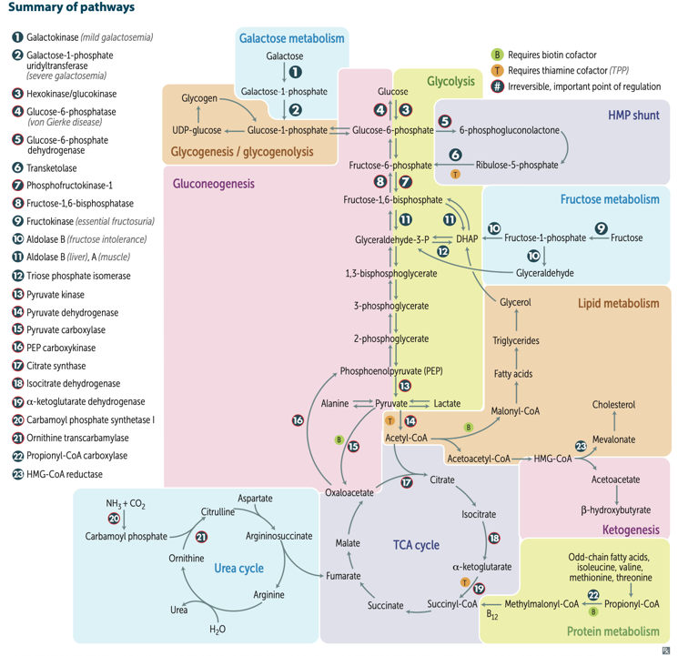

Slide 26
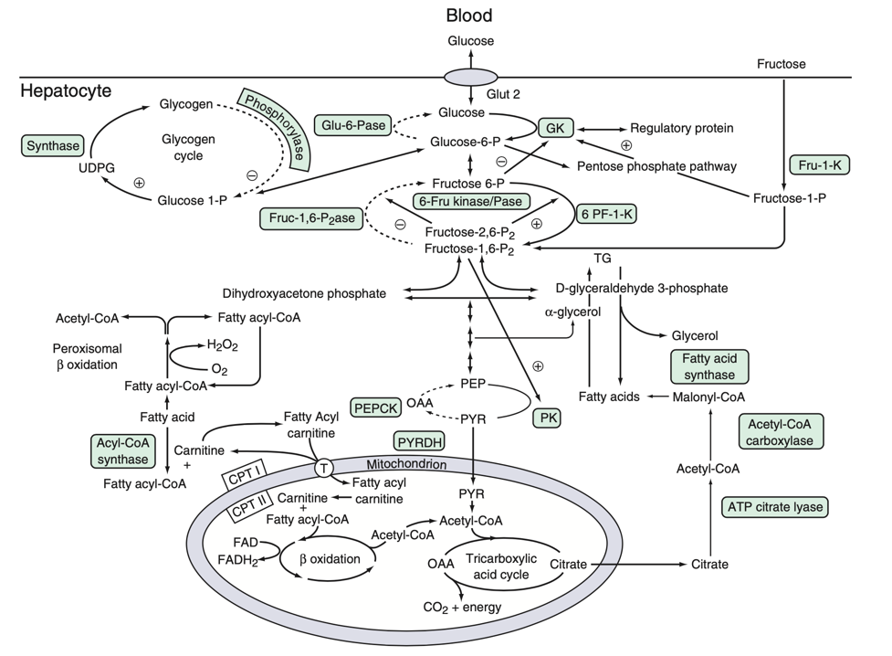

Slide 27
Liver Enzymes

Slide 28
Are all liver enzymes specific to the liver?

Slide 29
Aspartate aminotransferase (AST) and alanine aminotransferase (ALT)

Slide 30
AST and ALT Concentrations
AST
ALT
Liver
Cardiac muscle
Skeletal muscle
Kidney
Brain
Pancreas
Lung
Leukocytes
Erythrocytes

Slide 31
Function of ALT and AST
What functions do ALT and AST serve in hepatocytes?
What functions do they serve in serum?

Slide 32
Function of ALT and AST

Slide 33
Alkaline Phosphatase (ALP)

Slide 34
Alkaline Phosphatase (ALP)
ALPs are group of isoenzymes found in
Liver
Biliary tree
Kidney
Bone
Placenta

Slide 35
What do you do if there is isolated ALP elevation?

Slide 36
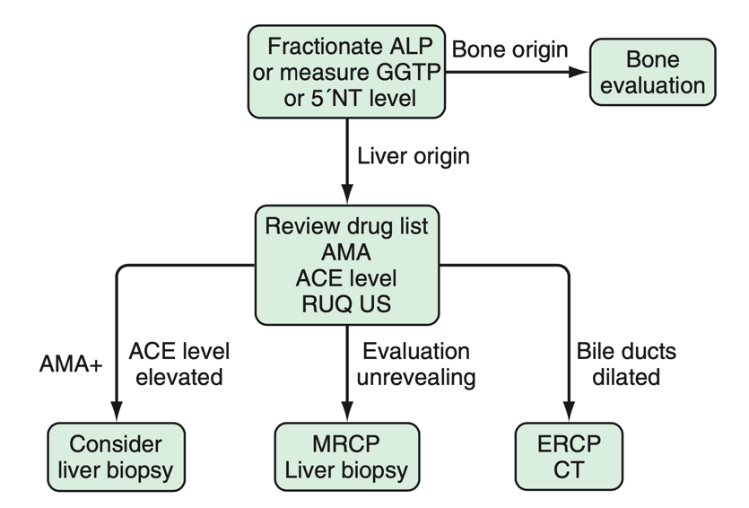
Alkaline Phosphatase (ALP)

Slide 37
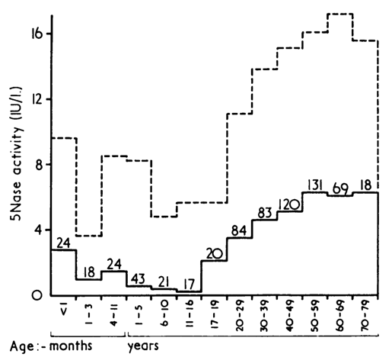
5′-Nucleotidase
Protein associated with sinusoidal and canalicular membranes.
Can differentiate liver from bone injury, unlike ALP.

Slide 38
Albumin and prothrombin time

Slide 39
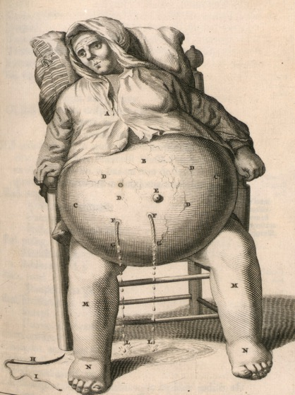
Albumin
“I have seen a beggar who voided milk in his urine for five years and this weakened him to death. When he added wine or vinegar to this urine it coagulated, or when he left it for a few days, cream separated on top”
- Paracelsus (1493–1541)
Produced exclusively by hepatocytes.
  15 g/day
Total body albumin 300-500 g
Half-life is days

Slide 40
Albumin
Can you measure Albumin as a screening tool for liver disease?

Slide 41
Albumin
Can you measure Albumin as a screening tool for liver disease? No.

Slide 42
Prothrombin time

Slide 43
Prothrombin time
All of the following coagulation factors are produced by the liver except:
I
III
IV
VIII
IX
XI
XII

Slide 44
Prothrombin time
All of the following coagulation factors are produced by the liver except:
I
III
IV
VIII – Where is it produced?
IX
XI
XII

Slide 45
Prothrombin time
What is the international normalized ratio?

Slide 46
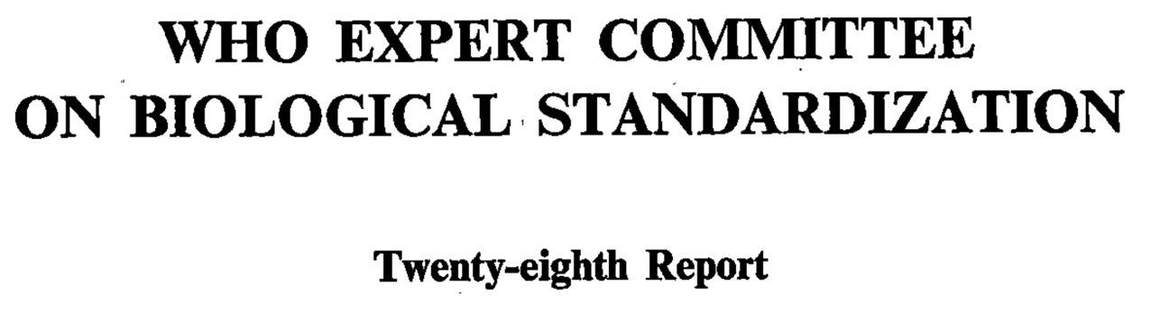
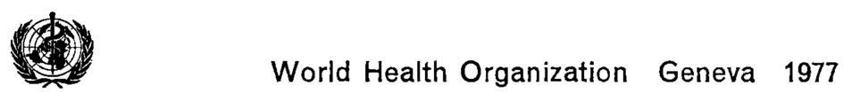
Prothrombin time
What is the international normalized ratio?

Slide 47
Prothrombin time
Can INR be used to assess risk of bleeding in patients with cirrhosis?

Slide 48
Prothrombin time
Can INR be used to assess risk of bleeding in patients with cirrhosis?
No.

Slide 49
Prothrombin time
Can INR be used to assess risk of bleeding in patients with cirrhosis?
No. Why?

Slide 50
Prothrombin time
Can INR be used to assess risk of bleeding in patients with cirrhosis?
No. Why?
INR assesses only the activity of procoagulant clotting factors, not anticoagulants such as protein C and antithrombin, the production of which is also reduced in cirrhosis.

Slide 51
Synthetic Function
Which of the following proteins decreases during the acute phase?
Ferritin
Ceruloplasmin
Albumin
Complement C3
Complement C4
Alpha Fetoprotein

Slide 52
Synthetic Function
Which of the following proteins decreases during the acute phase?
Ferritin
Ceruloplasmin
Albumin
Complement C3
Complement C4
Alpha Fetoprotein

Slide 53
Types of Abnormal Liver Tests

Slide 54
Types of Abnormal Liver Tests

Slide 55
Types of Abnormal Liver Tests
 | Mixed
 | Hepatocellular | Cholestatic
Enzyme elevation | AST and ALT | ALP, GGT and T. bili
Jaundice | +/- | +
Pruritis | No | Yes
Acute liver failure | Yes | Rare
Mortality | Up to 10% | < 1%

Slide 56
Evaluation of Cholestatic Liver Tests

Slide 57
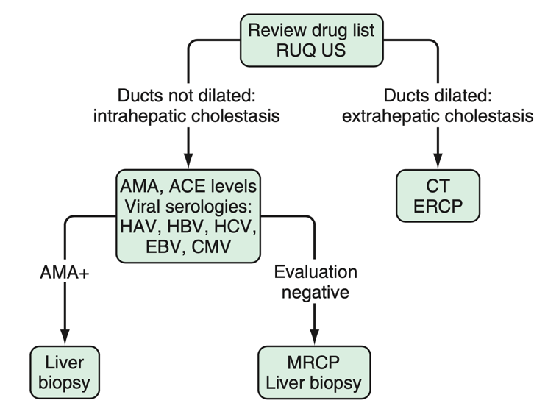
Evaluation of Cholestasis

Slide 58
Evaluation of Hepatocellular Liver Tests

Slide 59
Evaluation of Hepatocellular Liver Tests
Two questions to ask

Slide 60
Evaluation of Hepatocellular Liver Tests
Two questions to ask
Degree of elevation of AST and ALT
AST-to-ALT ratio

Slide 61
Why does AST-to-ALT ratio matter?
Which conditions have a high AST-to-ALT ratio?

Slide 62
Why does AST-to-ALT ratio matter?
Which conditions have a high AST-to-ALT ratio?

Slide 63
Why does AST-to-ALT ratio matter?
Which conditions have a high AST-to-ALT ratio?
Alcoholic hepatitis
Cirrhosis

Slide 64
Why does AST-to-ALT ratio matter?
Which conditions have a high AST-to-ALT ratio?
Alcoholic hepatitis – Why?
Cirrhosis – Why?

Slide 65
The complicated story of PLP, AST and ALT

Slide 66
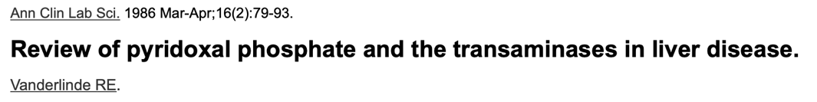
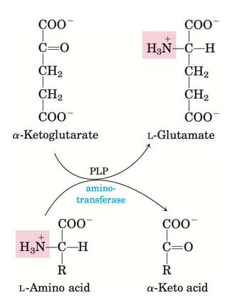
The complicated story of PLP, AST and ALT

Slide 67
Causes of Hepatocellular Injury

Slide 68
Causes of Hepatocellular Injury
AST Territory
Normal
ALT Territory

Slide 69
Causes of Hepatocellular Injury
Alcohol-related liver injury (AST/ALT > 2:1, AST nearly always <300 U/L)
Cirrhosis
Medications or toxins in a patient with underlying alcoholic liver
injury
Acute rhabdomyolysis
AST Territory
Normal
AST>ALT
ALT>AST
α1-Antitrypsin deficiency
Autoimmune hepatitis
Chronic viral hepatitis
Hemochromatosis
Medications and toxins
Steatosis and steatohepatitis Wilson disease
Acute bile duct obstruction
Acute Budd-Chiari syndrome
Acute viral hepatitis
Autoimmune hepatitis
Drugs and toxins
Hepatic artery ligation
Ischemic hepatitis
Wilson disease
ALT Territory

Slide 70
Can you differentiate ischemic and viral hepatitis?

Slide 71
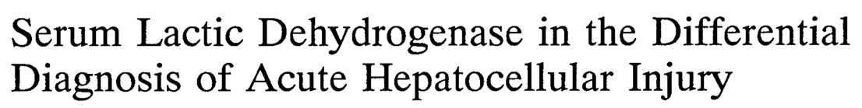
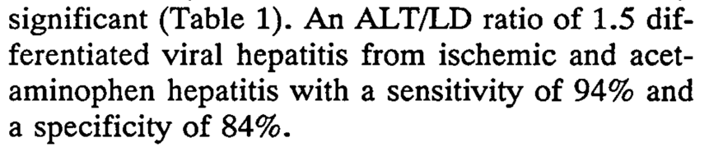
Can you differentiate ischemic and viral hepatitis?

Slide 72
Who is the sickest patient?
 | Patient 1 | Patient 2 | Patient 3 | Patient 4 | Patient 5
AST ALT T bili ALP GGT Albumin INR Platelets | 300 130 4 100 90 3.5 1.3 200,000 | 10,000 100 0.3 50 40 2.4 2.1 150,000 | 30 20 4 40 30 5.1 3.0 350,000 | 10,000 12,000 1.0 200 150 3.0 1.2 210,000 | 3,000 2,500 3 1,500 1,000 2.0 1.0 200,000
Diagnosis?

Slide 73
Who is the sickest patient?
 | Patient 1 | Patient 2 | Patient 3 | Patient 4 | Patient 5
AST ALT T bili ALP GGT Albumin INR Platelets | 300 130 4 100 90 3.5 1.3 200,000 | 10,000 100 0.3 50 40 2.4 2.1 150,000 | 30 20 4 40 30 5.1 3.0 350,000 | 10,000 12,000 1.0 200 150 3.0 1.2 210,000 | 3,000 2,500 3 1,500 1,000 2.0 1.0 200,000
Diagnosis?

Slide 74
Who is the sickest patient?
 | Patient 1 | Patient 2 | Patient 3 | Patient 4 | Patient 5
AST ALT T bili ALP GGT Albumin INR Platelets | 300 130 4 100 90 3.5 1.3 200,000 | 10,000 100 0.3 50 40 2.4 2.1 150,000 | 30 20 4 40 30 5.1 3.0 350,000 | 10,000 12,000 1.0 200 150 3.0 1.2 210,000 | 3,000 2,500 3 1,500 1,000 2.0 1.0 200,000
Diagnosis? | Alcoholic hepatitis | Rhabdo-myolysis | Acute liver failure | Acetamino-phen toxicity | Viral hepatitis

Slide 75
“The degree of elevation of the aminotransferases does not correlate with the extent of liver injury”

Slide 76
Approach to Asymptomatic Elevation of Liver Enzymes

Slide 77
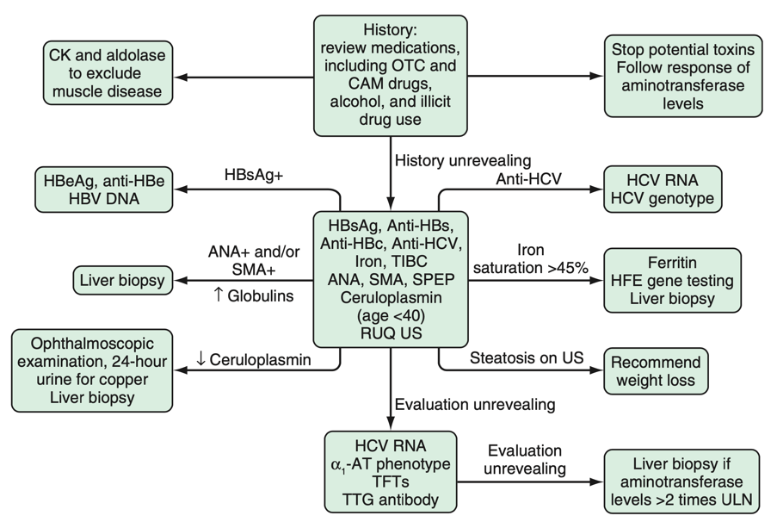
Approach to Asymptomatic Elevation of Liver Enzymes

Slide 78
Hy’s Law

Slide 79
Hy’s Law
Specifically for drug-induced liver injury (DILI)

Slide 80

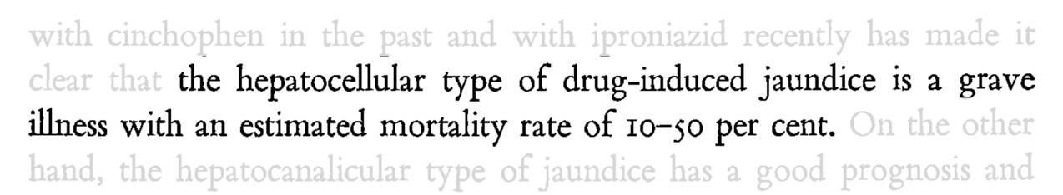

Hy’s Law

Slide 81
Hy’s Law
The drug causes hepatocellular injury, generally shown by a higher incidence of 3-fold or greater elevations above the ULN of ALT or AST than the (nonhepatotoxic) control drug or placebo
Among trial subjects showing such AT elevations, often with ATs much greater than 3xULN, one or more also show elevation of serum TBL to >2xULN, without initial findings of cholestasis (elevated serum ALP)
No other reason can be found to explain the combination of increased AT and TBL, such as viral hepatitis A, B, or C; preexisting or acute liver disease; or another drug capable of causing the observed injury

Slide 82
Hy’s Law
When aminotransferase elevations are associated with clinical jaundice the risk of mortality is increased to as high as 10% in DILI

Slide 83
Treatment

Slide 84
Treatment
Depends on cause

Slide 85
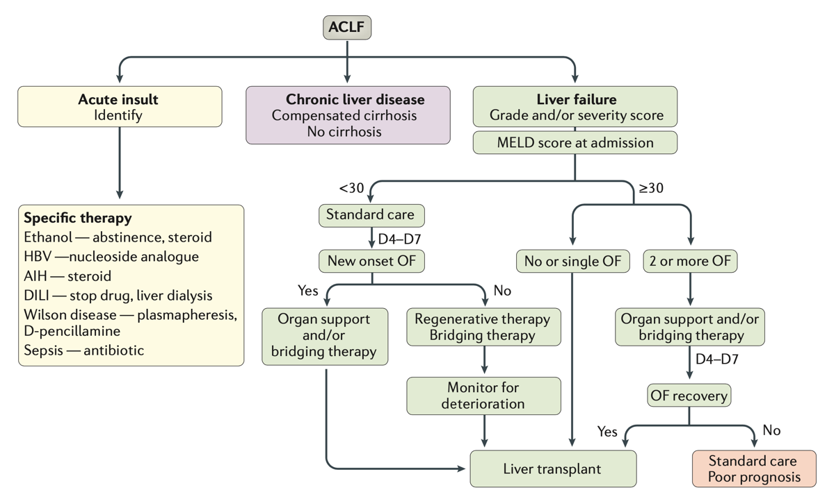

Slide 87
Acute Liver Failure

Slide 88
Acute Liver Failure
Definition?

Slide 89
Acute Liver Failure
Acute liver injury
Coagulopathy (INR > 1.5)
Encephalopathy

Slide 90
Acute Liver Failure
Acute liver injury
Coagulopathy (INR > 1.5)
Encephalopathy
Do you have to have all three?

Slide 91
Acute Liver Failure
Acute liver injury
Coagulopathy (INR > 1.5)
Encephalopathy
Do you have to have all three?
Yes.

Slide 92
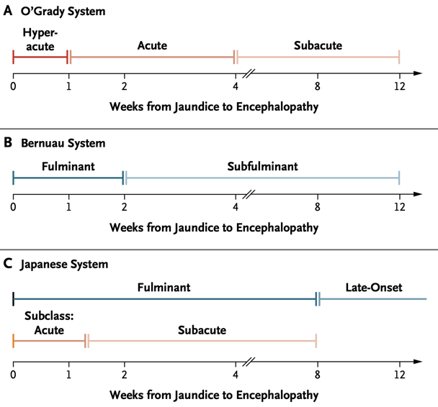
Classification of ALF

Slide 93
What are the features of a patient with ALF (apart from the definition)?

Slide 94
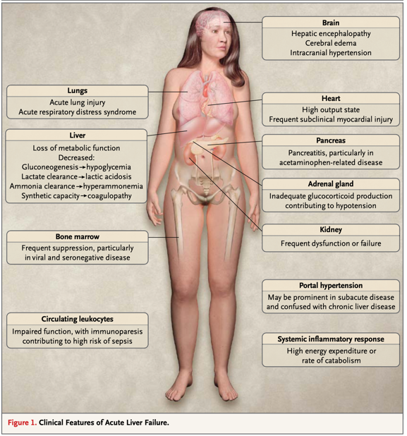
Features of ALF

Slide 95
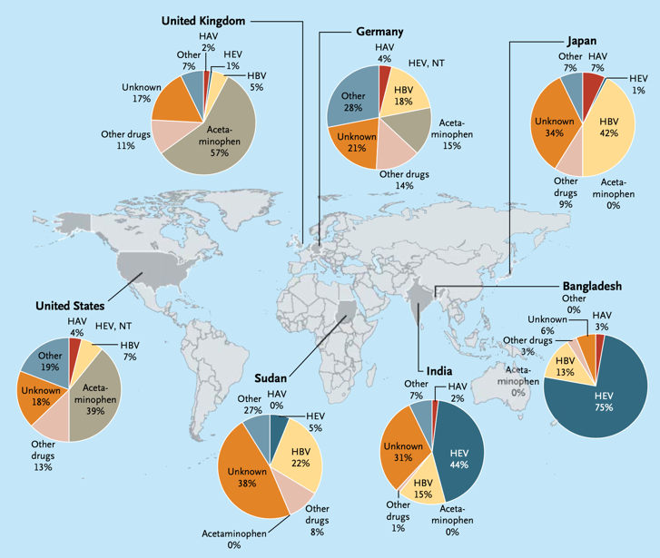
Causes of ALF Worldwide

Slide 96
Treatment of ALF

Slide 97
Treatment of ALF
Metabolic and nutritional support
Prognostic evaluation
Transplantation
Other therapies

Slide 98
Metabolic and nutritional support
ALF patients are prone to hypoglycemia -> support by D5 fluids
Avoid large volume hypotonic fluids -> Why?

Slide 99
Metabolic and nutritional support
ALF patients are prone to hypoglycemia -> support by D5 fluids
Avoid large volume hypotonic fluids -> Can cause hyponatremia and brain edema

Slide 100
Metabolic and nutritional support
ALF patients are prone to hypoglycemia -> support by D5 fluids
Avoid large volume hypotonic fluids -> Can cause hyponatremia and brain edema
If encephalopathic provide 1-1.5 g/kg of protein daily
Trend ammonia

Slide 101
Metabolic and nutritional support
ALF patients are prone to hypoglycemia -> support by D5 fluids
Avoid large volume hypotonic fluids -> Can cause hyponatremia and brain edema
If encephalopathic provide 1-1.5 g/kg of protein daily
Trend ammonia – Why?

Slide 102
Metabolic and nutritional support
ALF patients are prone to hypoglycemia -> support by D5 fluids
Avoid large volume hypotonic fluids -> Can cause hyponatremia and brain edema
If encephalopathic provide 1-1.5 g/kg of protein daily
Trend ammonia – Will help guide protein supplementation, but does not provide prognostic value

Slide 103
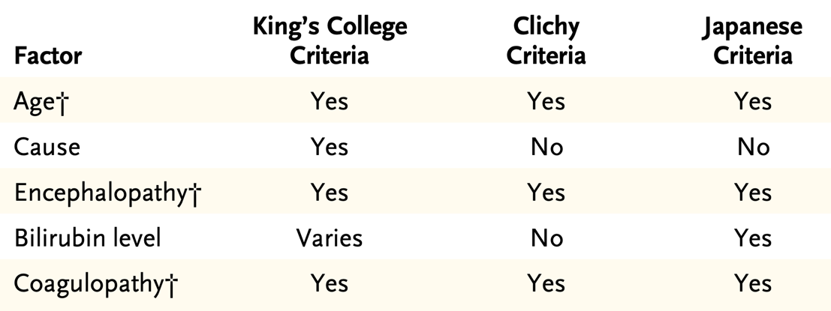
Prognostic evaluation

Slide 104
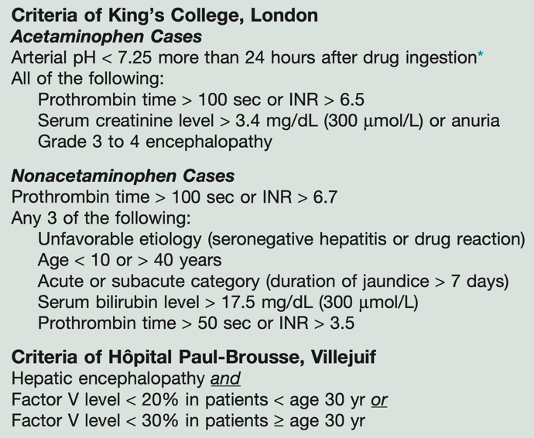
Criteria for Liver Transplantation in ALF

Slide 105
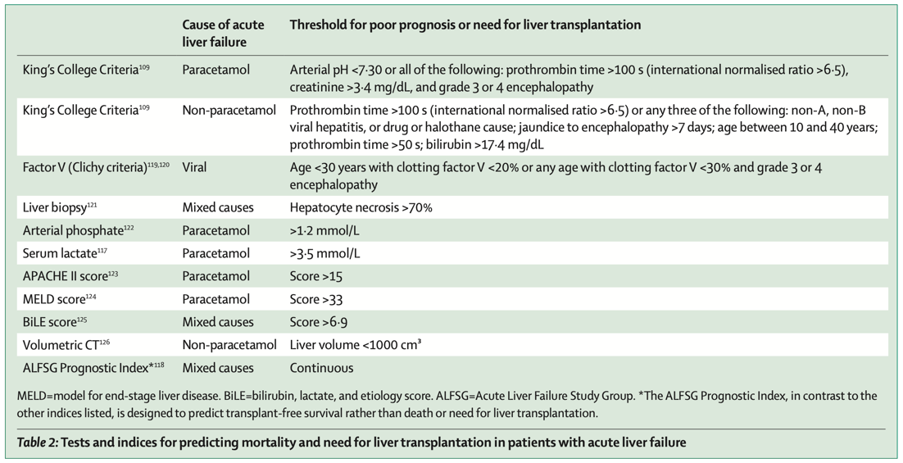
Criteria for Liver Transplantation in ALF

Slide 106
How about chronic liver disease and cirrhosis, is there a score?

Slide 107
Model For End-Stage Liver Disease (MELD)

Slide 108
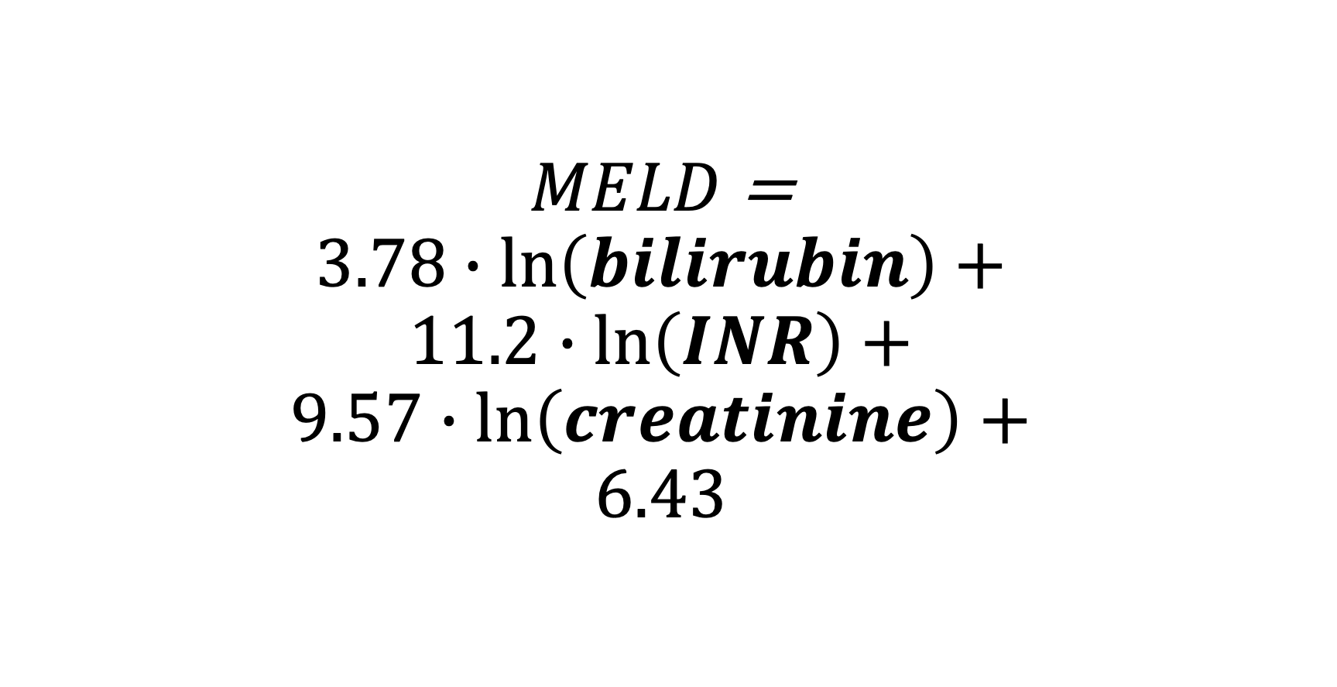
Model For End-Stage Liver Disease (MELD) Score
$MELD$ =
$$3.78∙\ln\left(bilirubin\right)+$$
$$11.2∙\ln\left(INR\right)+$$
$$9.57∙\ln\left(creatinine\right)+$$
$$6.43$$

Slide 109
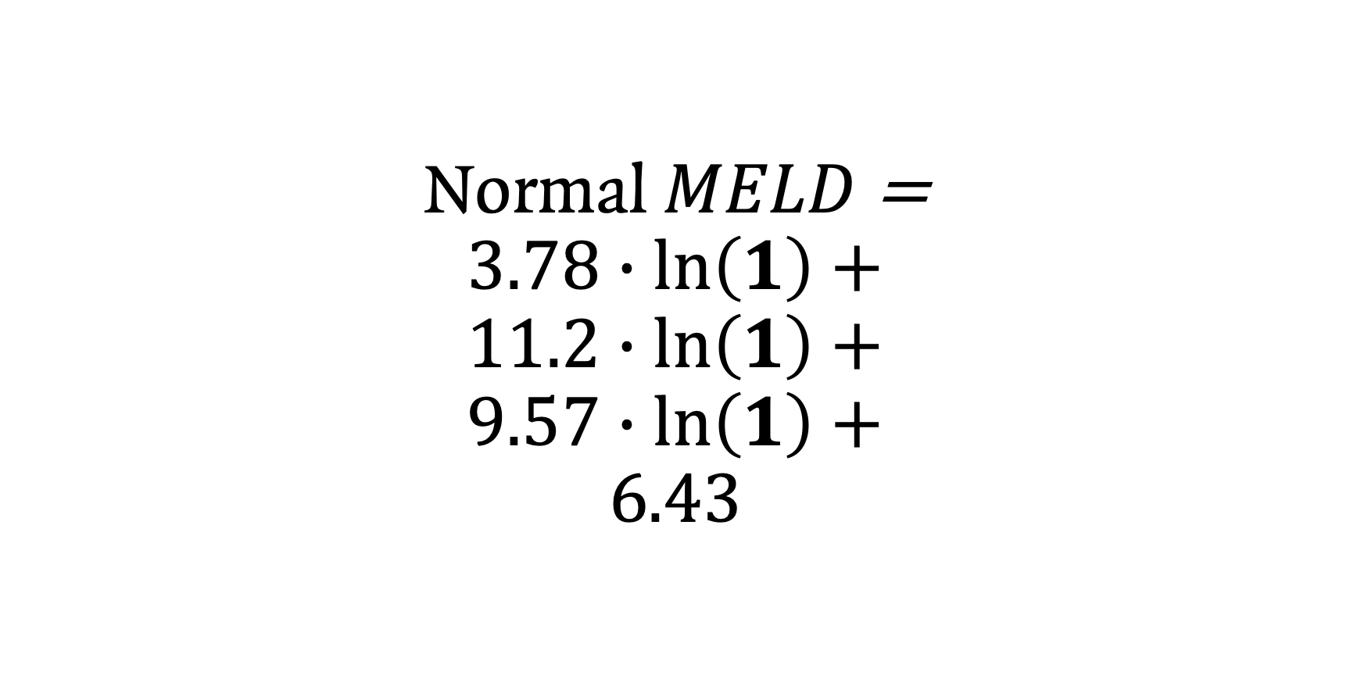
Model For End-Stage Liver Disease (MELD) Score
Normal $MELD$ =
$$3.78∙\ln\left(1\right)+$$
$$11.2∙\ln\left(1\right)+$$
$$9.57∙\ln\left(1\right)+$$
$$6.43$$

Slide 110
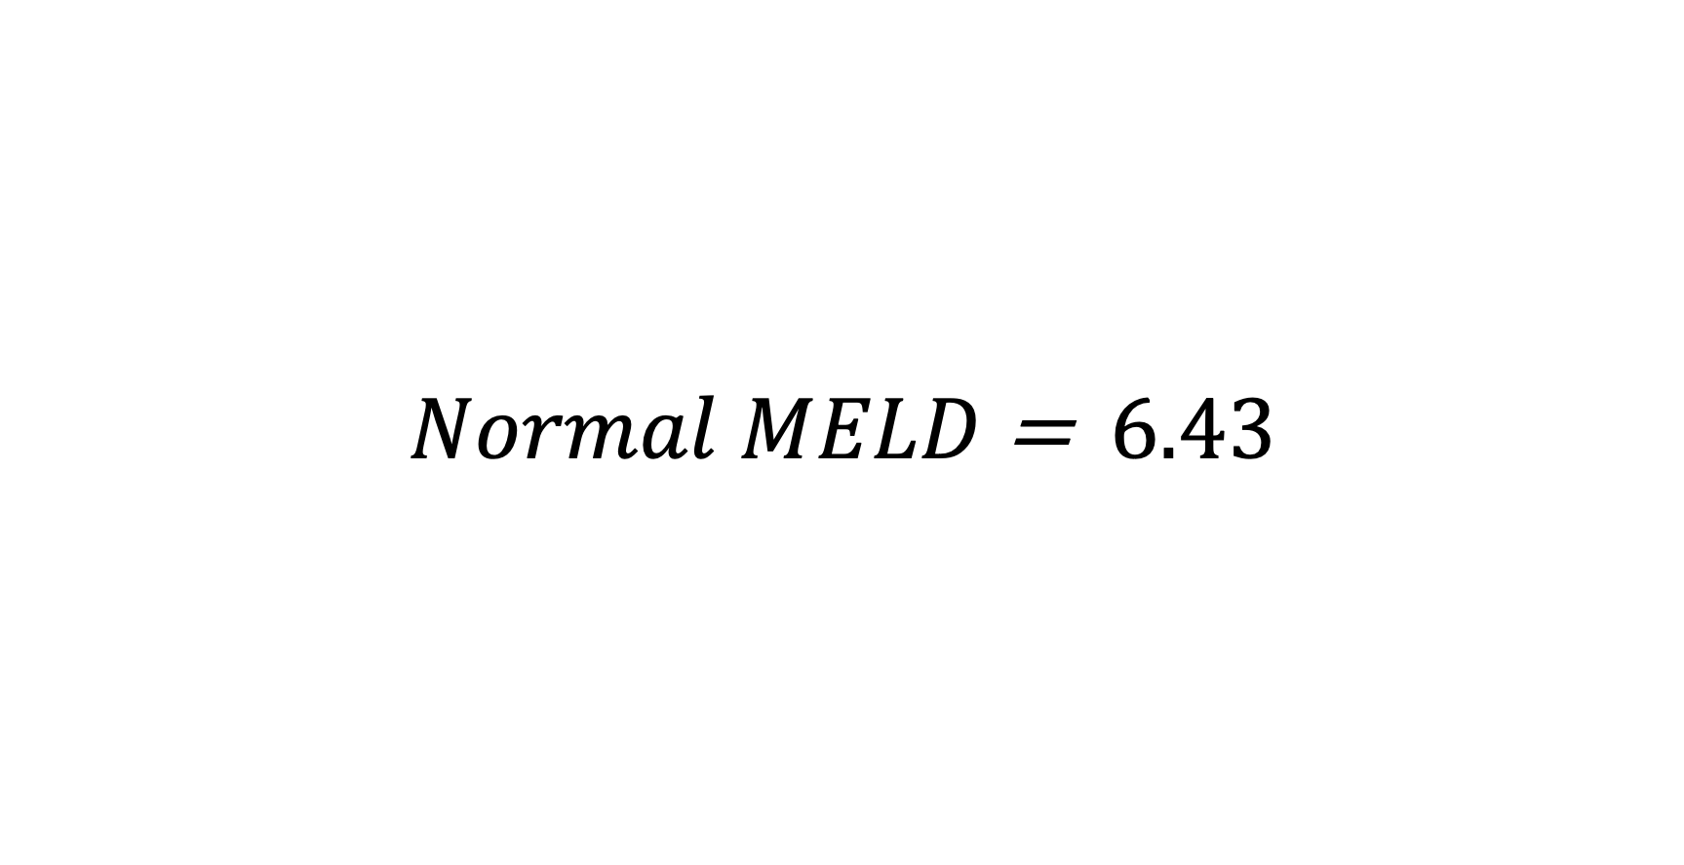
Model For End-Stage Liver Disease (MELD) Score
$Normal MELD$ = $6.43$

Slide 111
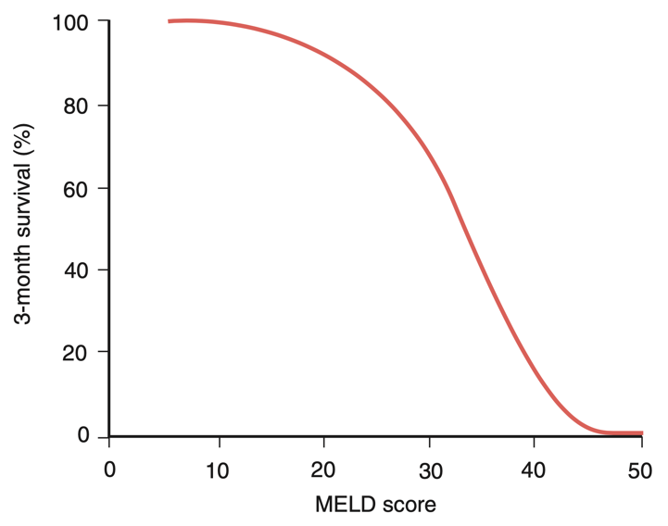
MELD Score

Slide 112
MELD Score
Starts at MELD = 6

Slide 113
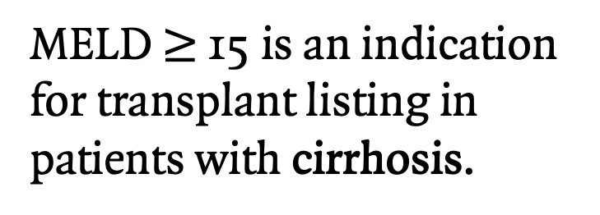
MELD Score
MELD $≥$ 15 is an indication for transplant listing in patients with cirrhosis.

Slide 114
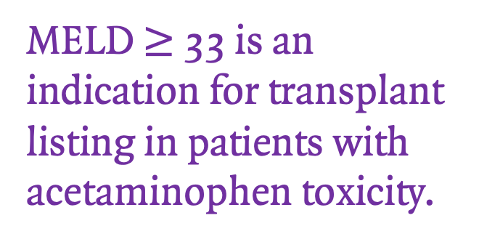
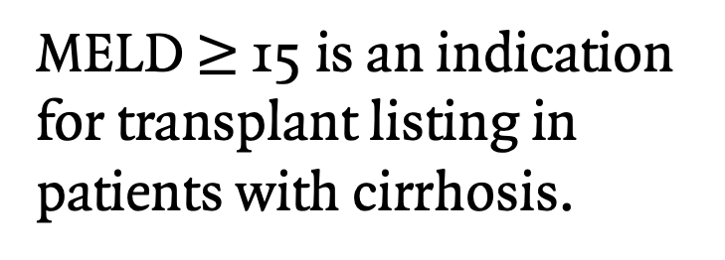
MELD Score
MELD $≥$ 15 is an indication for transplant listing in patients with cirrhosis.
MELD $≥$ 33 is an indication for transplant listing in patients with acetaminophen toxicity.

Slide 115
Liver Transplantation

Slide 116
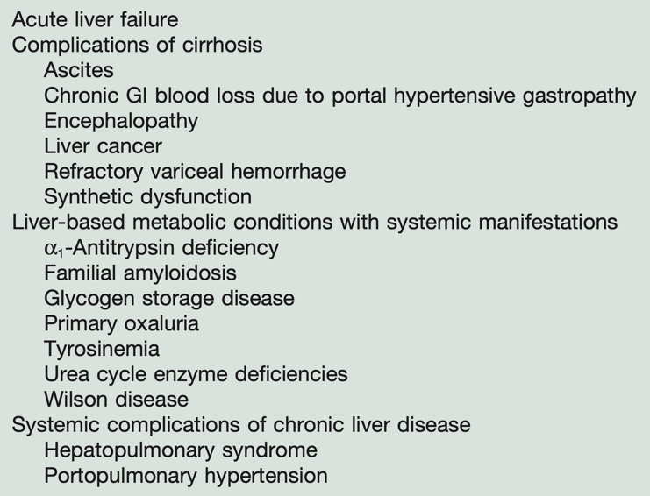
Indications for Liver Transplantation

Slide 117
What about contraindications for liver transplant?

Slide 118
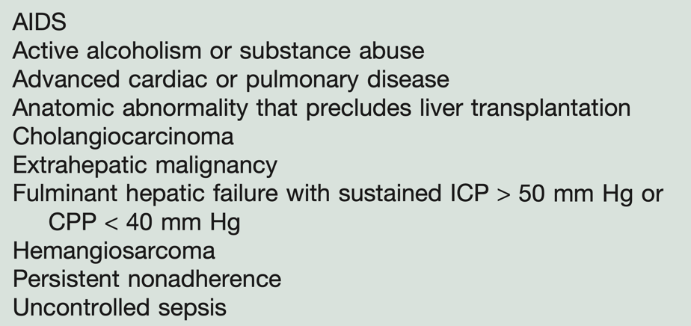
Contraindications for Liver Transplantation

Slide 119
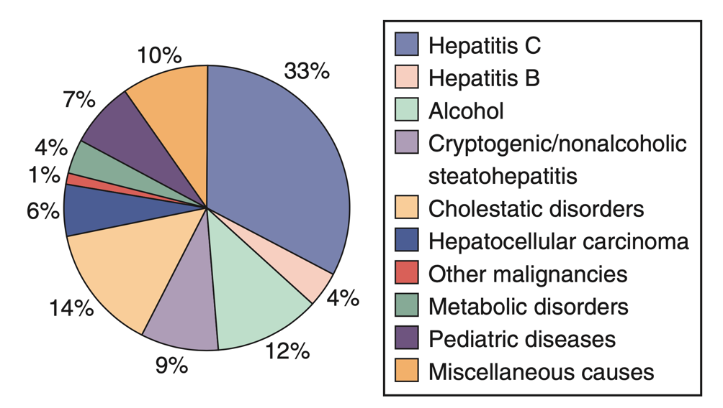
Overall Reasons for Liver Transplantation

Slide 120
Back to the algorithm

Slide 122
But wait…

Slide 123

But wait…

Slide 124

But wait…

Slide 125
But wait…
Liver dialysis???

Slide 126
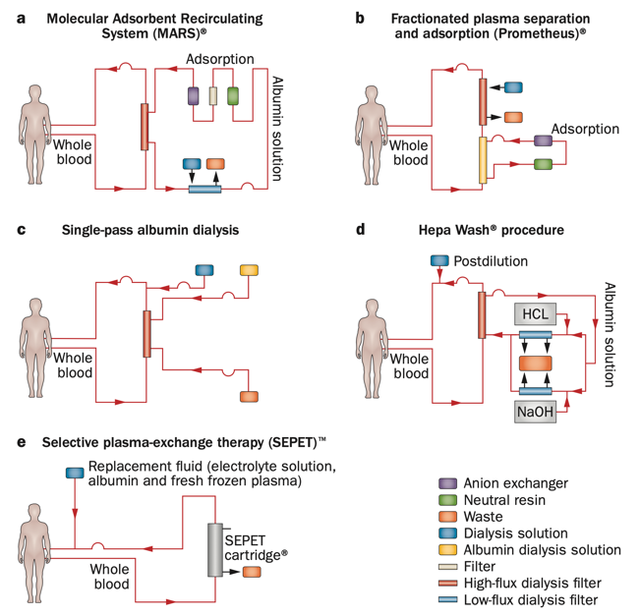
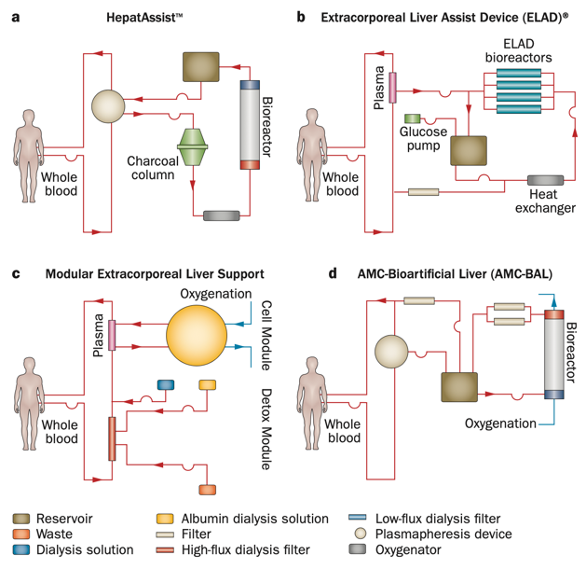
Artificial liver support systems
Bioartifical liver support devices

Slide 127
Artificial and bioartificial liver support systems
Only meant for bridging until transplantation
Although some systems showed promise in resolving encephalopathy, none have shown mortality benefit yet

Slide 128
Thank you

